Slide 1
Sprint 1: FanAssist
Daily Fantasy Sports Optimizer
Charity Brown, Andy Johnson, Elizabeth Payne, Gage Wassweiler
Notes:
“Title slide with all names”
Presenter 1

Slide 2
Overview
The purpose of the FanAssist app is to assist daily fantasy sports users create a optimized lineup for competitions by leveraging FanDuel and DraftKings. Users can optimize their lineup based on detailed player statistics, player salary, salary cap.
Notes:
“Reminder of the project focus”
Presenter 1 - Gage

Slide 3
Sprint 1 Deliverables/Goal
Website
Project Overview
Project Goals
Technical Features
About Us
FanDuel - NBA Optimization Lineup
Select Desired Players
Show Optimized Lineup
Database with player stats
Linear regression model to predict scores
Backlogs and Hindsight Review
Project Backlog
Spring 1 Backlog
Sprint 1 Retrospective
Notes:
“Sprint Goal”
Gage wassweiler

Slide 4
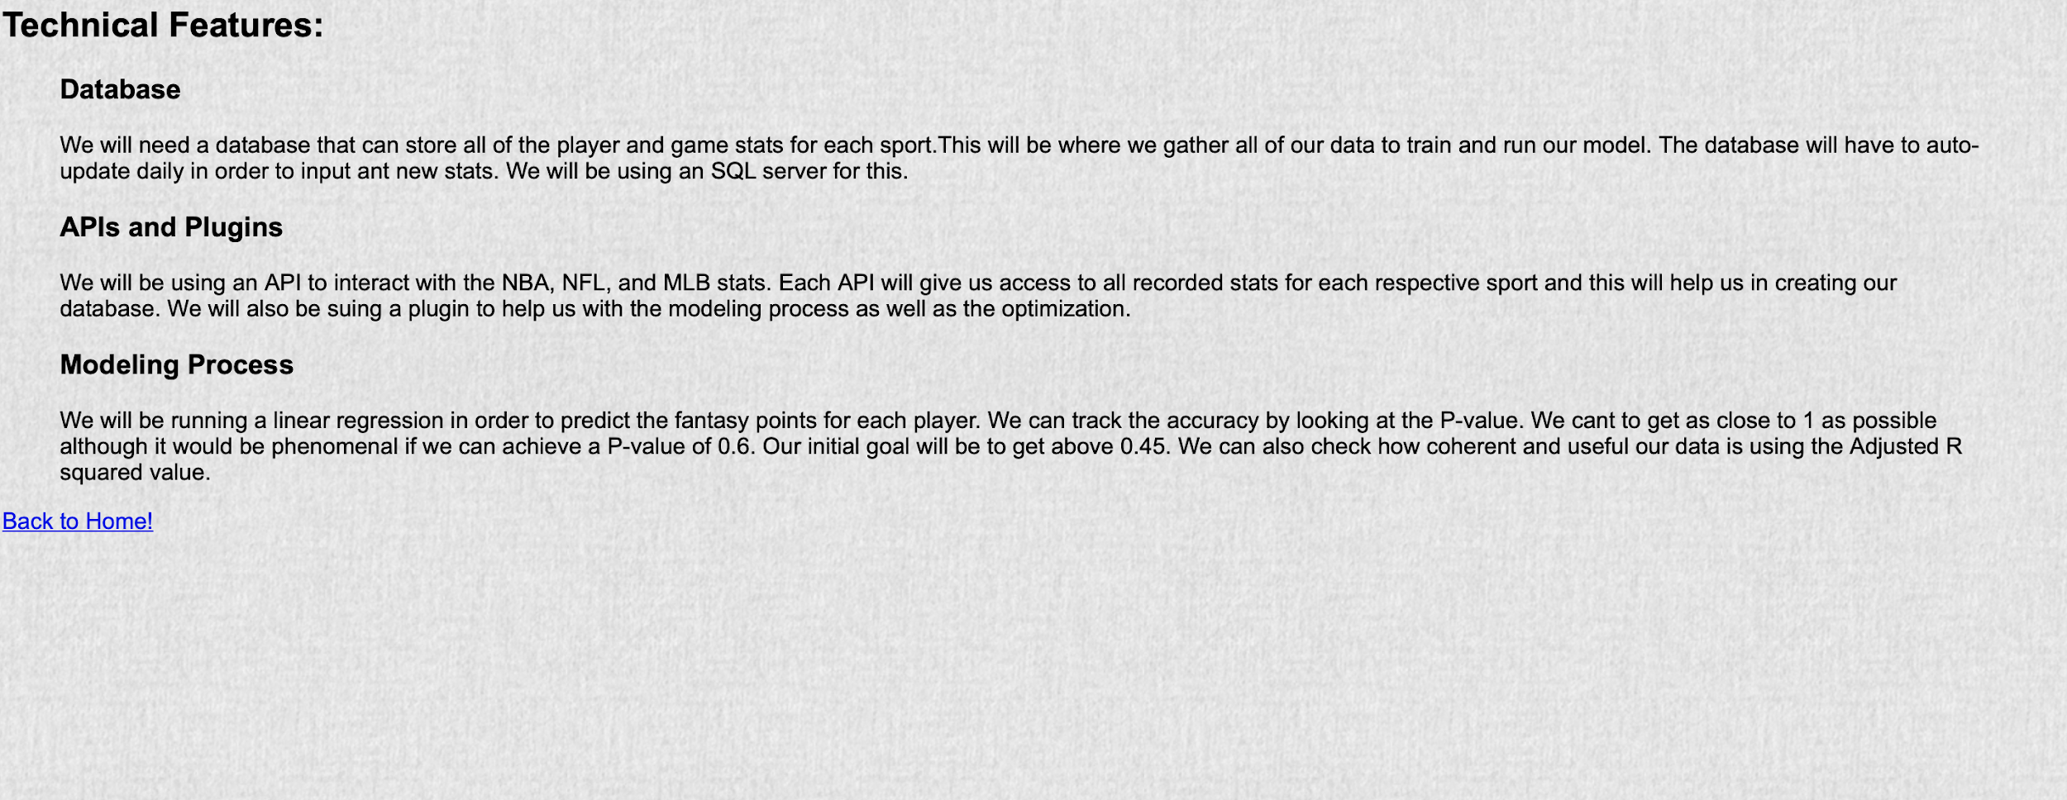
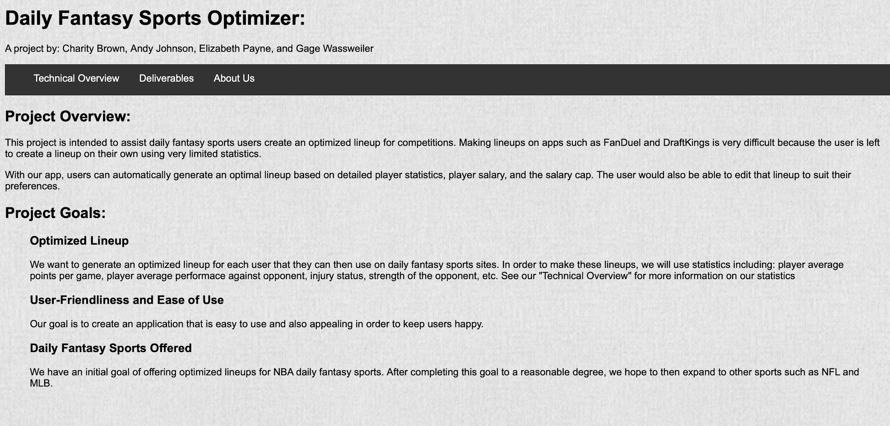
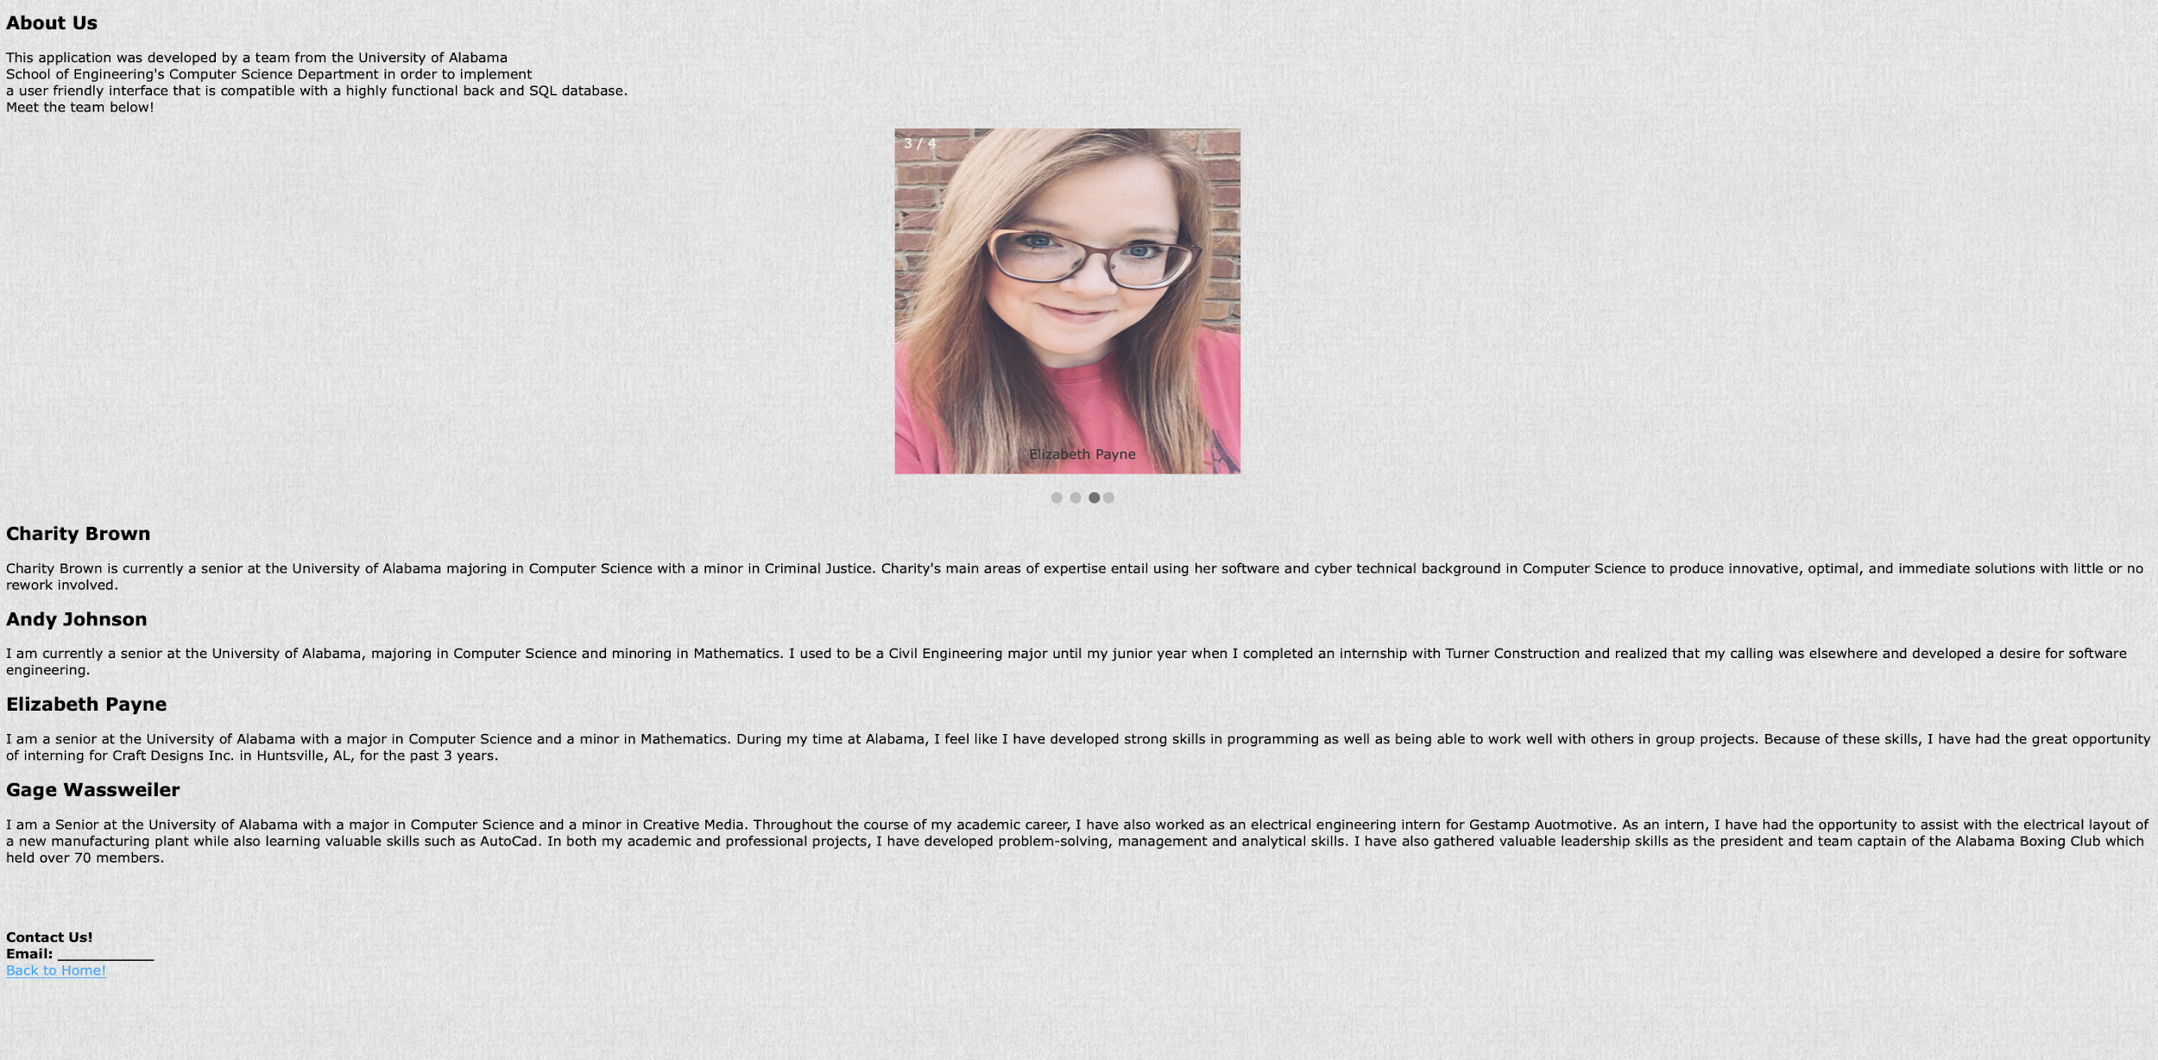
Website
Notes:
“Sprint Achievements” Slide 4-7
Elizabeth

Slide 5
User Interface
Select which platform to reference: FanDuel or DraftKings
Select Sport: NBA
Select Players (if any) desired in your lineup
Request an Optimized lineup
Challenges & Solutions
Finding a middle man between the User Interface and Back End Database to interpret Java to Python
Using http connections to make a request from the User Interface to the Back End Database
Import Volley library
Notes:
“Sprint Achievements” Slide 4-7
Elizabeth

Slide 6
Back-end
MySQL Database hosted on AWS
Optimization is done in python and runs through a linear regression model.
Trained the model by running every stat through it dating back to 1998
First used Kmeans algorithm to group players into certain roles
Challenges & Solutions
Finding a host for the Back End Database
Amazon Web Services
Interacting between Python and the database to insert hundreds of thousands stats in order to create the most accurate model
Improving P value and R^2 value
Notes:
“Sprint Achievements” Slide 4-7
Gage wassweiler

Slide 7
Web Server
Communication between client and server is done through http get requesting
Web server is done through Flask for Python
Server is currently hosted locally, but will be moved to a remote host in the future
Front-end sends a url with player names appended to it representing the user choices
Back end creates a lineup in json format and returns to the front end via the request
Challenges & Solutions
Figuring out how to set up one of our machines to host the server properly
Deciding on what format to send our data back to the front end
Receiving and parsing data from the request on the front end was challenging initially
Notes:
“Sprint Achievements” Slide 4-7
Presenter 3
Andy

Slide 8
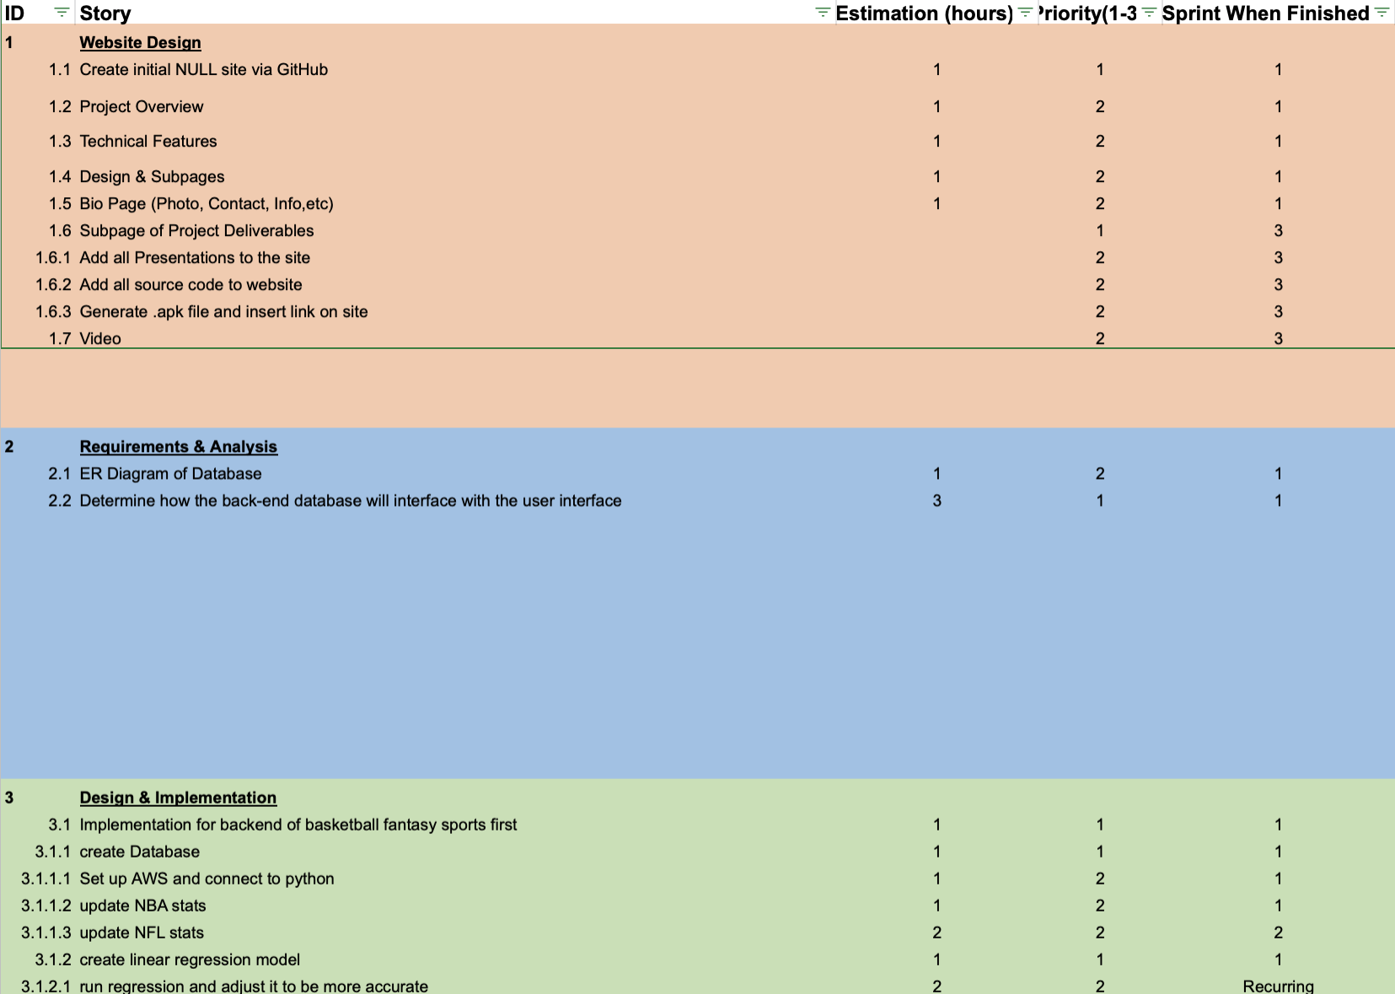
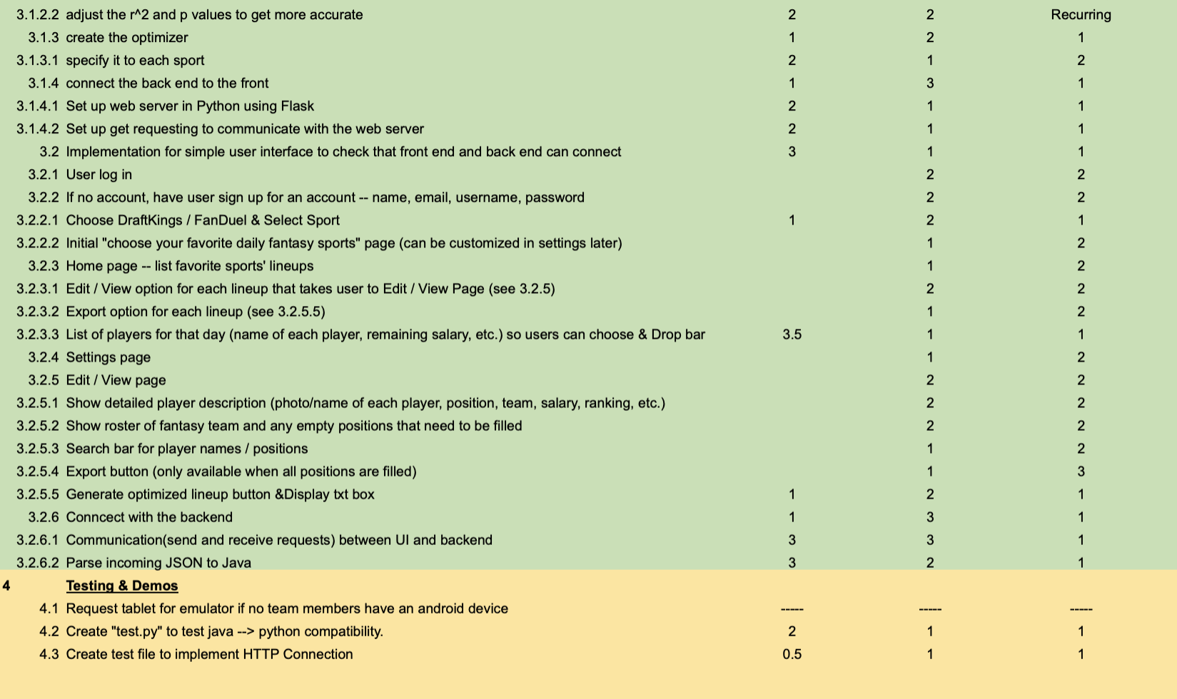
Project Backlog
Notes:
“Project Backlog and Sprint Backlog”
Presenter 4 - Charity

Slide 9
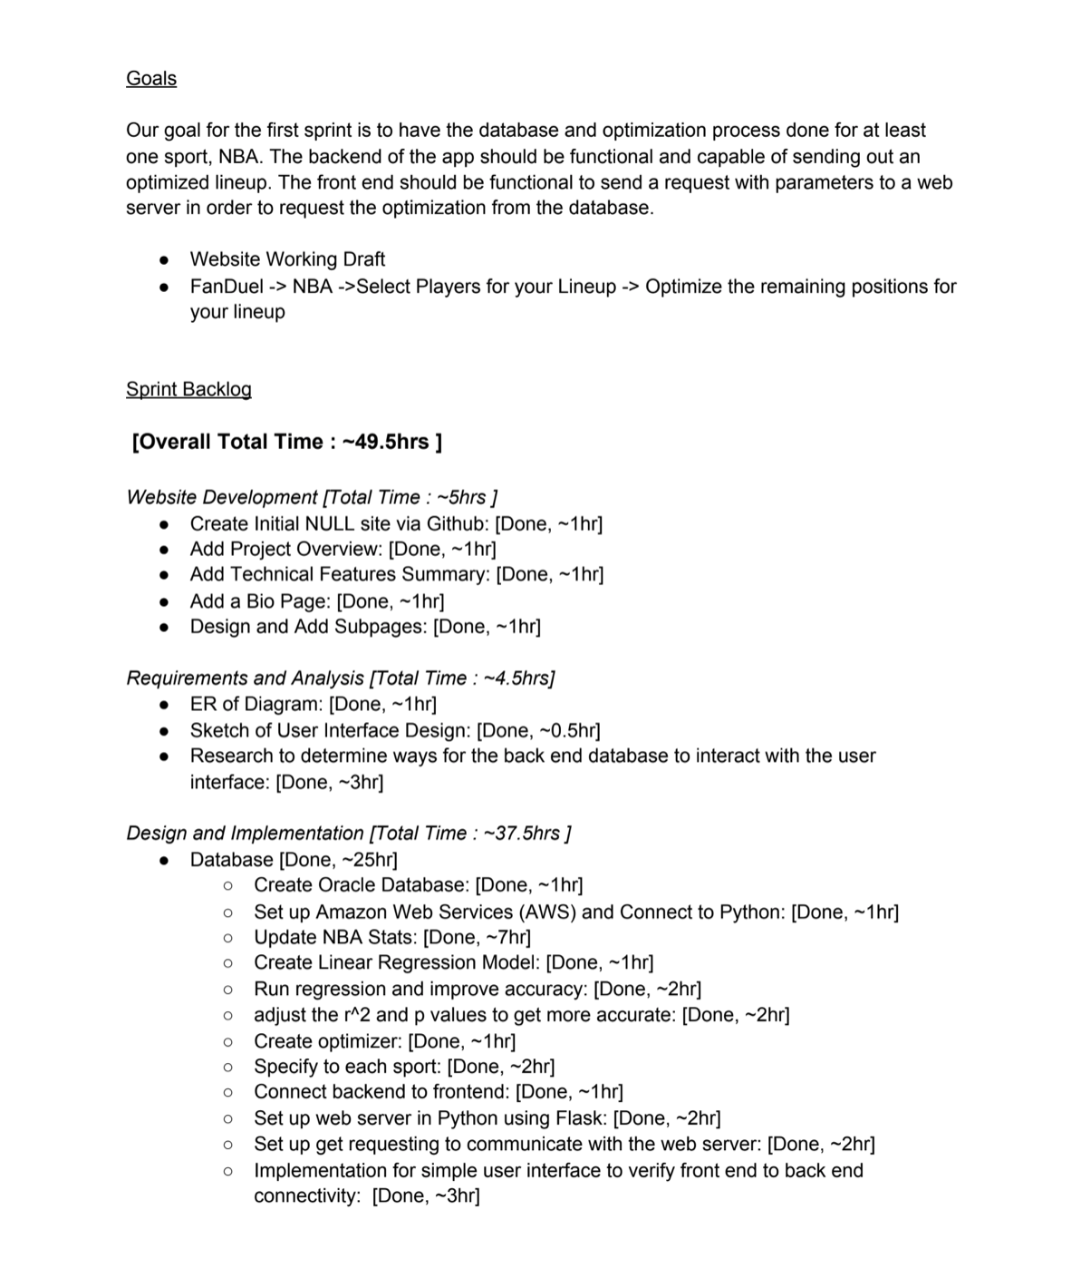
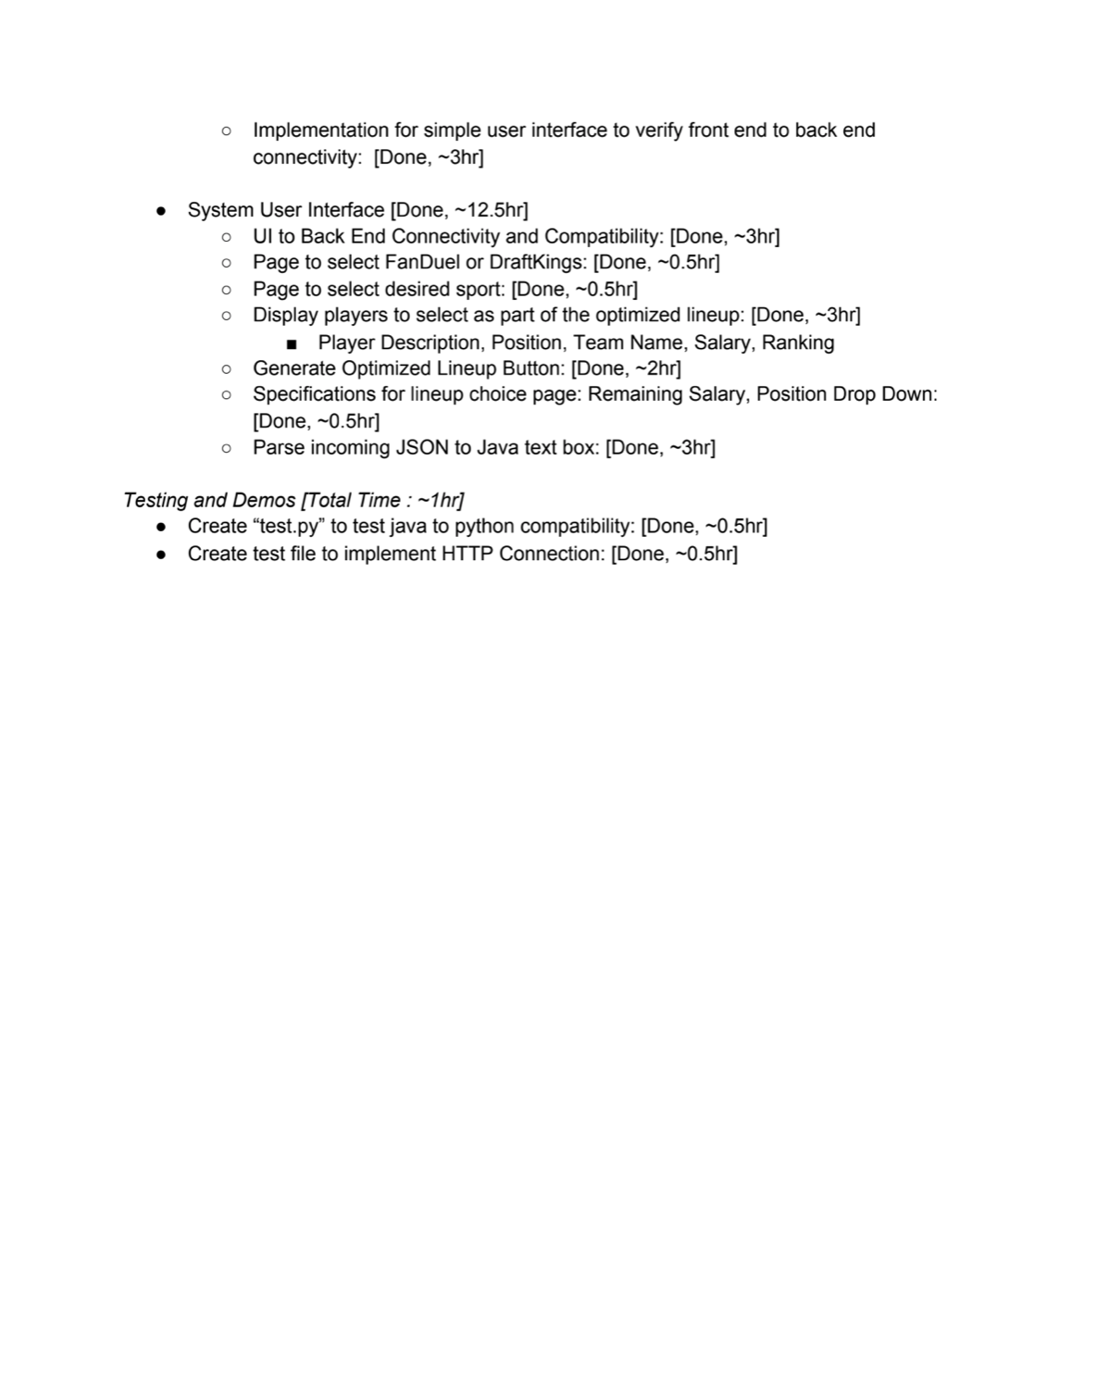
Sprint 1 Backlog
Notes:
“Project Backlog and Sprint Backlog”
Presenter 4 - Charity

Slide 10
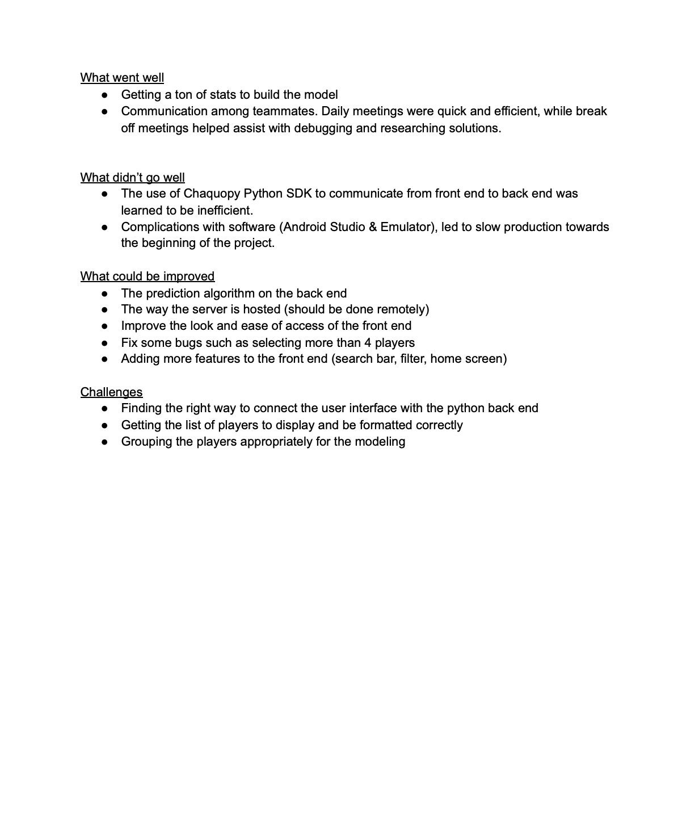
Sprint 1 Retrospective
Notes:
“Project Backlog and Sprint Backlog”
Presenter 4 - Charity

Slide 11
Next Steps
Host web server on AWS (or other service if makes sense)
User login / account
Home screen
Search bar and filter for list of players
Create a more detailed preview of players / lineups
Implement DraftKings
Improve P value by adding more stats such as matchups
Measure of accuracy
Notes:
“What was not completed/Lessons Learned”
Presenter 4
Andy

